Slide 1
Vision Transformers
Kang Xin
kx111@mail.ustc.edu.cn
2021/11/07

Slide 2
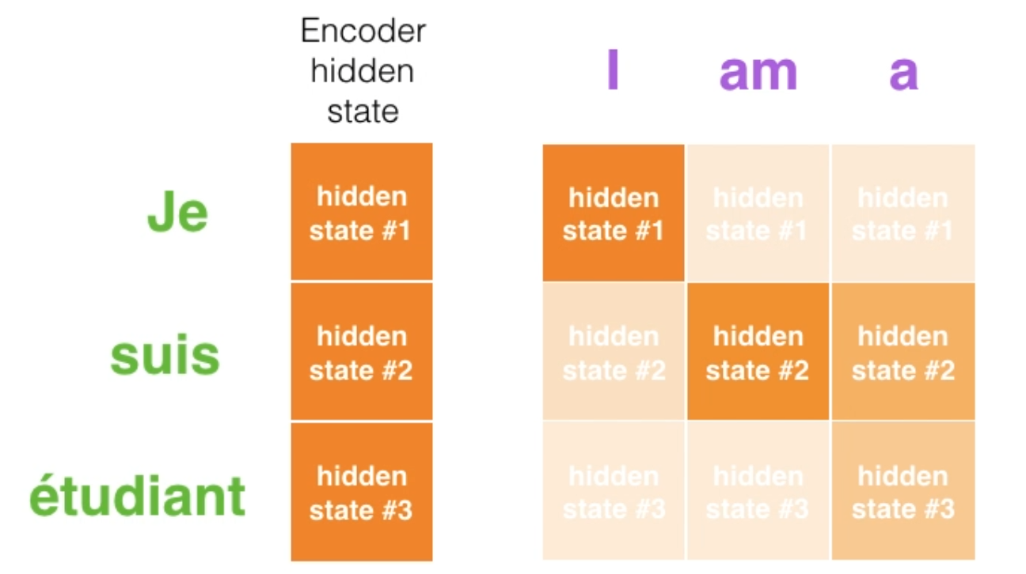
Review Attention
Why we need attention?
We want each output item to focus on its most relevant parts from the input sequence.
Notes:
Given a data sequence, we want to focus on most related data while we encoding each of them.

Slide 3

Review Transformer
Why we need transformer?
Enable parallelization when processing input sequence.
Draw global dependencies between input and output.

Slide 4
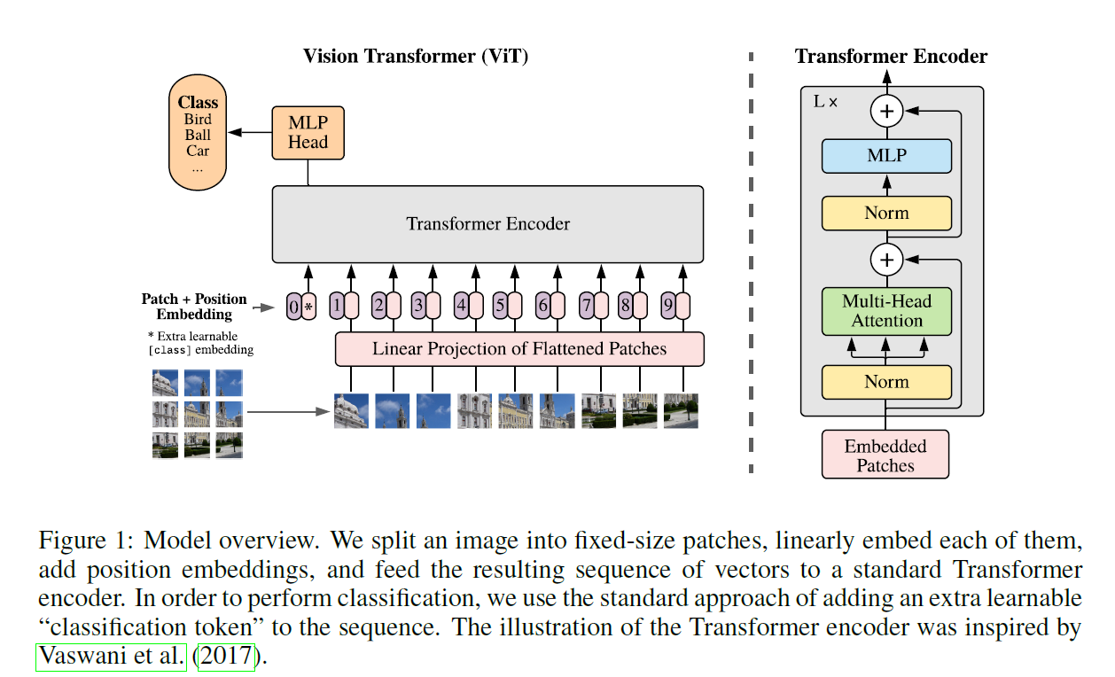
Review Vision Transformer

Slide 5
Review Vision Transformer
Pros: better classification performance compared to convolution-based network.
Cons: need to pretrain on large datasets.

Slide 6
Pyramid Vision Transformer: A Versatile Backbone for Dense Prediction without Convolutions
Wenhai Wang, Enze Xie, Xiang Li, Deng-Ping Fan, Kaitao Song, Ding Liang, Tong Lu, Ping Luo, Ling Shao
Nanjing University, The University of Hong Kong,
Nanjing University of Science and Technology, IIAI, SenseTime Research
ICCV 2021 Oral

Slide 7
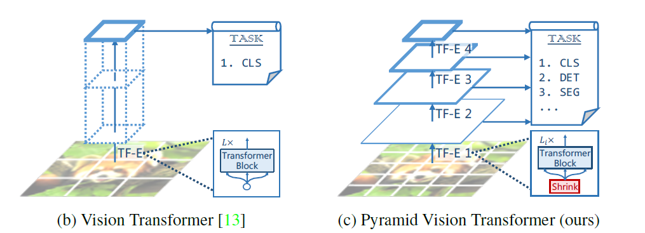
Motivation
Overcome the difficulties of porting Transformer to various dense prediction tasks.
ViT cannot apply to pixel-level prediction, because,
Its output feature is single-scale and low resolution
Its computational and memory costs are relatively high.

Slide 8
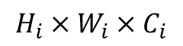
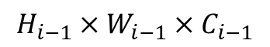
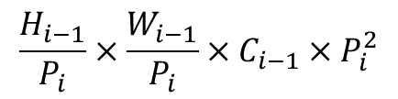
Architecture Design
1. Input Resolution
ViT: 16 x 16 PVT: H/4 x W/4
2. Progressive Shrinking for Multi-scale Feature Maps
$$H_{i−1}×W_{i−1}×C_{i−1}$$
$$H_{i}×W_{i}×C_{i}$$
$$\frac{H_{i−1}}{P_{i}}×\frac{W_{i−1}}{P_{i}}×C_{i−1}×P_{i}^{2}$$

Slide 9
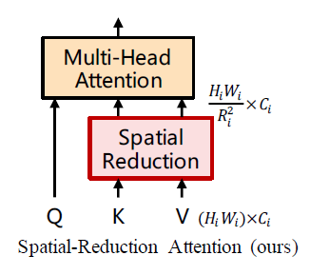
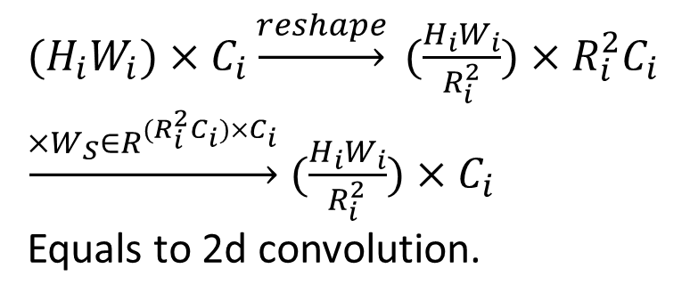
Architecture Design
3. Spatial Reduced Attention (SRA)
${(H}_{i}W_{i})×C_{i}\underset{→}{reshape} (\frac{H_{i}W_{i}}{R_{i}^{2}})×R_{i}^{2}C_{i}$
$\underset{→}{×W_{S}∈R^{(R_{i}^{2}C_{i})×C_{i}}}(\frac{H_{i}W_{i}}{R_{i}^{2}})×C_{i}$
Equals to 2d convolution.

Slide 10
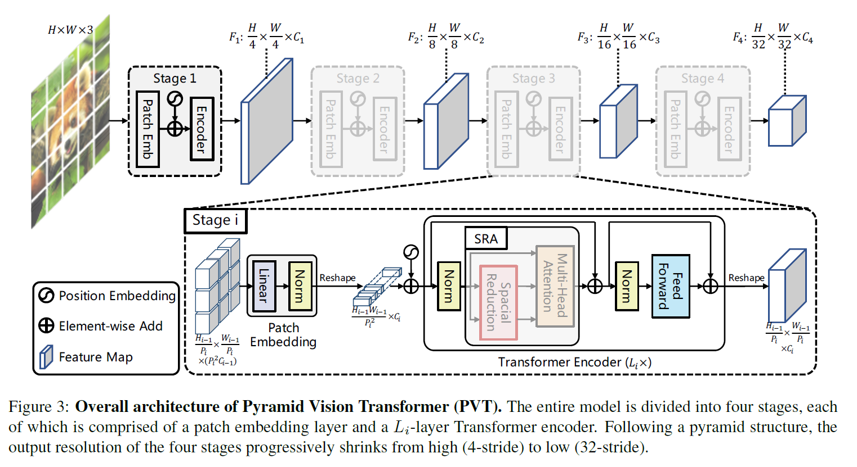
Architecture

Slide 11
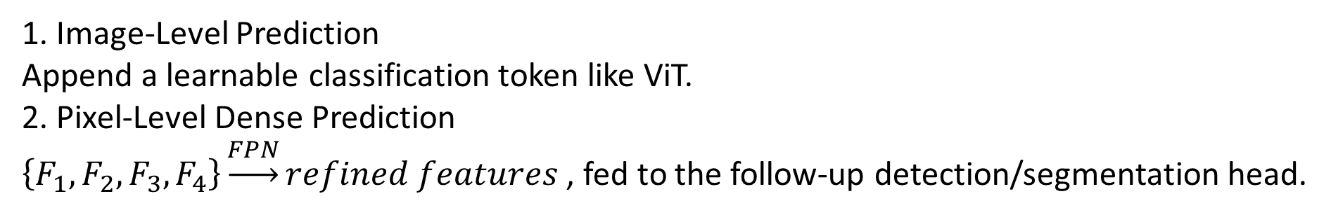
Application to Downstream Tasks
1. Image-Level Prediction
Append a learnable classification token like ViT.
2. Pixel-Level Dense Prediction
$\left\{F_{1},F_{2},F_{3},F_{4}\right\}\underset{→}{FPN}refined features$ , fed to the follow-up detection/segmentation head.

Slide 12
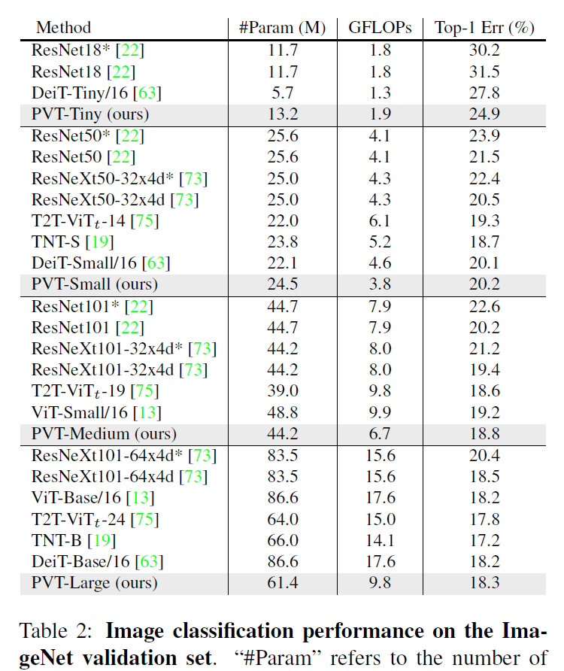
Classification

Slide 13
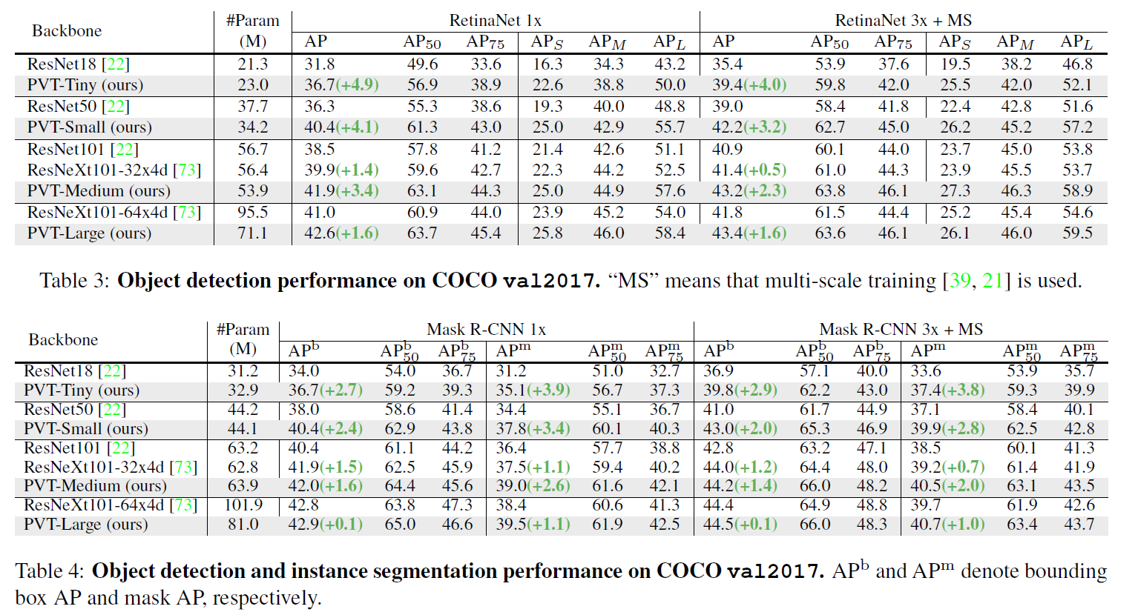
Detection

Slide 14
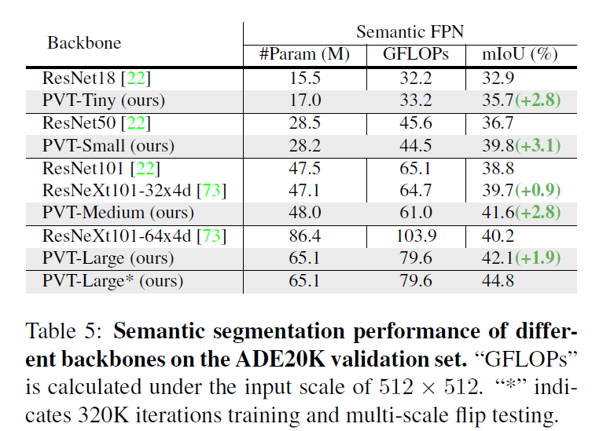
Segmentation

Slide 15
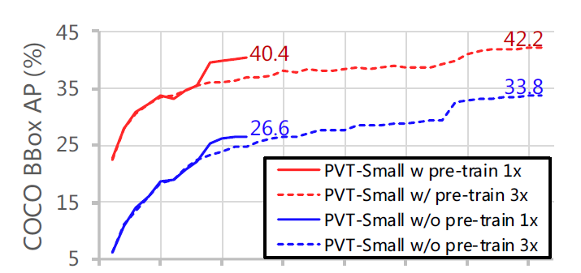
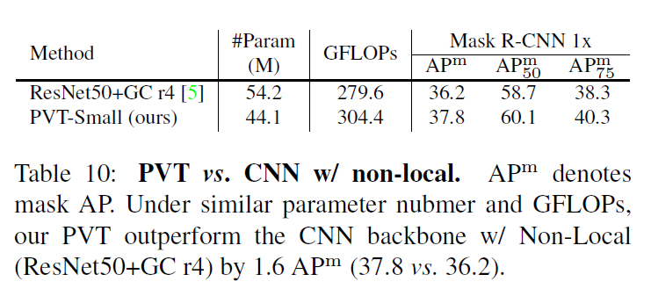
Ablation

Slide 16
Swin Transformer: Hierarchical Vision Transformer using Shifted Windows
Ze Liu, Yutong Lin, Yue Cao, Han Hu, Yixuan Wei, Zheng Zhang, Stephen Lin, Baining Guo
MSRA, ICCV 2021, Marri Prize

Slide 17
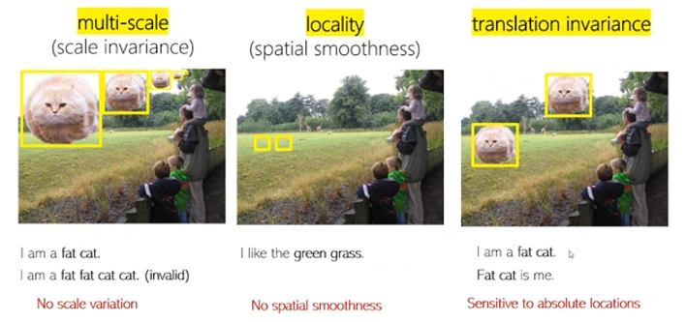
Motivation
Differences exist between vision domain and language domain.

Slide 18
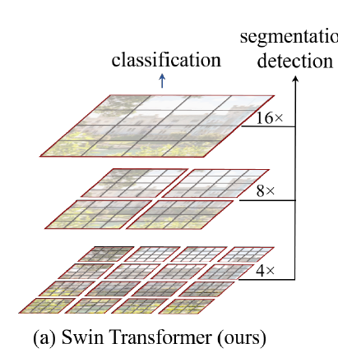
Swin-Transformer: the bridge from NLP to CV
1. Locality
Split image into small patches.
Compute Self-Attention locally within non-overlapping windows.
2. Multi-Scale
Swin-Transformer constructs a hierarchical representation.
Gradually merging neighboring patches in deeper layers.
Computation Scope of Self-Attention
Patch / Feature bin

Slide 19
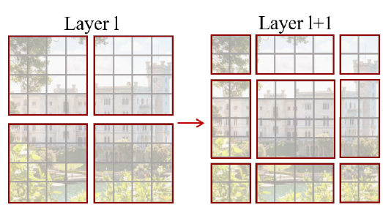
Swin-Transformer: the bridge from NLP to CV
3. Translation Invariance
Shifted windows bridge the windows of the preceding layer,
providing connections among them.
Computation Scope of Self-Attention
Patch / Feature bin

Slide 20
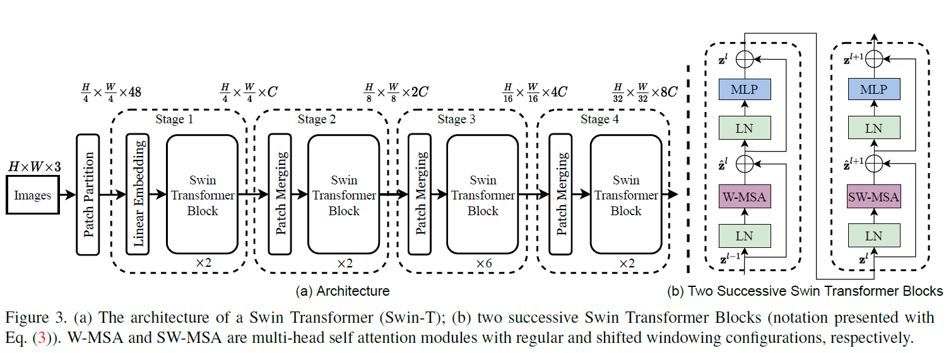
Architecture

Slide 21
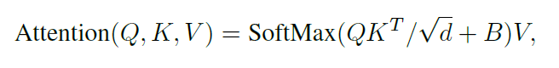
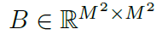
Relative Position Bias
Parameterize the relative position.

Slide 22
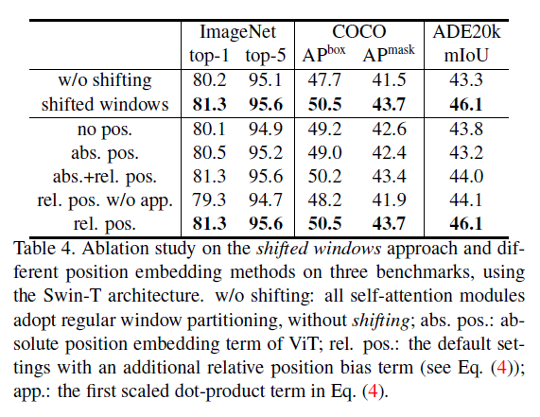
Ablation Study
Notes:
Optimizer
Window size
Patch size

Slide 23
Conclusion
Both Pyramid Vision Transformer and Swin-Transformer are designed according to properties of vision domain.

